Slide 1
Super Mall Web Application
Manage Shop’s Offer,Products
Anmol khari
Notes:
封面标题特殊字体为百度简综艺.可以自行下载使用或改为微软雅黑.

Slide 2
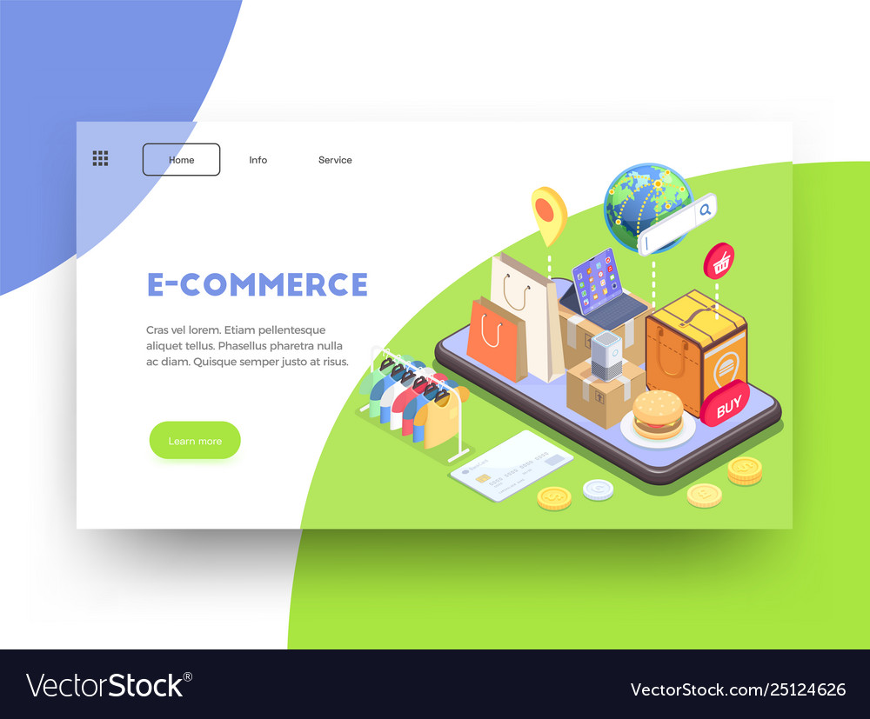
Introduction
The Super Mall Web Application functions as an independent platform that connects merchants and users. It integrates with databases to store product information, user data, and transaction details, ensuring a seamless interaction and efficient transaction processing.
Today, we'll be taking a deep dive into the world of online shopping and exploring the amazing features of the Super Mall Web Application. From its user-friendly interface to its secure login system, we'll show you how this application can revolutionize your shopping experience. So sit back, relax, and get ready to explore the future of online shopping!

Slide 3
Objective
The objective of this presentation is to provide an in-depth understanding of the Super Mall Web Application. We will cover the technologies used, key features, architecture, and challenges faced during development.
By the end of this presentation, you will have a clear idea of what makes the Super Mall Web Application unique and why it's worth exploring further.
Rural towns often struggle to reach a wider customer base for their commodities. the SuperMall Web Application aims to address this problem by providing a platform wheremerchants can advertise and sell their products to a global audience, expanding their reachand improving business prospects.

Slide 4

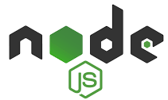
Technologies Used:
1. MongoDb
MongoDB is a NoSQL database that provides a flexible and scalable way to store and retrieve data. It uses a document-based model, allowing developers to store data in JSON-like
documents. MongoDB is well-suited for handling large volumes of data and provides powerful querying and indexing capabilities.
2.Node.js
Express is a minimalist web application framework for Node.js. It provides a set of tools
and features that simplify the development of web applications, such as routing, middleware
support, and handling HTTP requests and responses. Express is lightweight and flexible,
allowing developers to build robust APIs and server-side functionality

Slide 5


Technologies Used:
3. Express.js
Express is a minimalist web application framework for Node.js. It provides a set of tools
and features that simplify the development of web applications, such as routing, middleware
support, and handling HTTP requests and responses. Express is lightweight and flexible,
allowing developers to build robust APIs and server-side functionality.
4.HTML
The HyperText Markup Language or HTML is the standard markup language for documents designed to be displayed in a web browser. It defines the meaning and structure of web content.

Slide 6
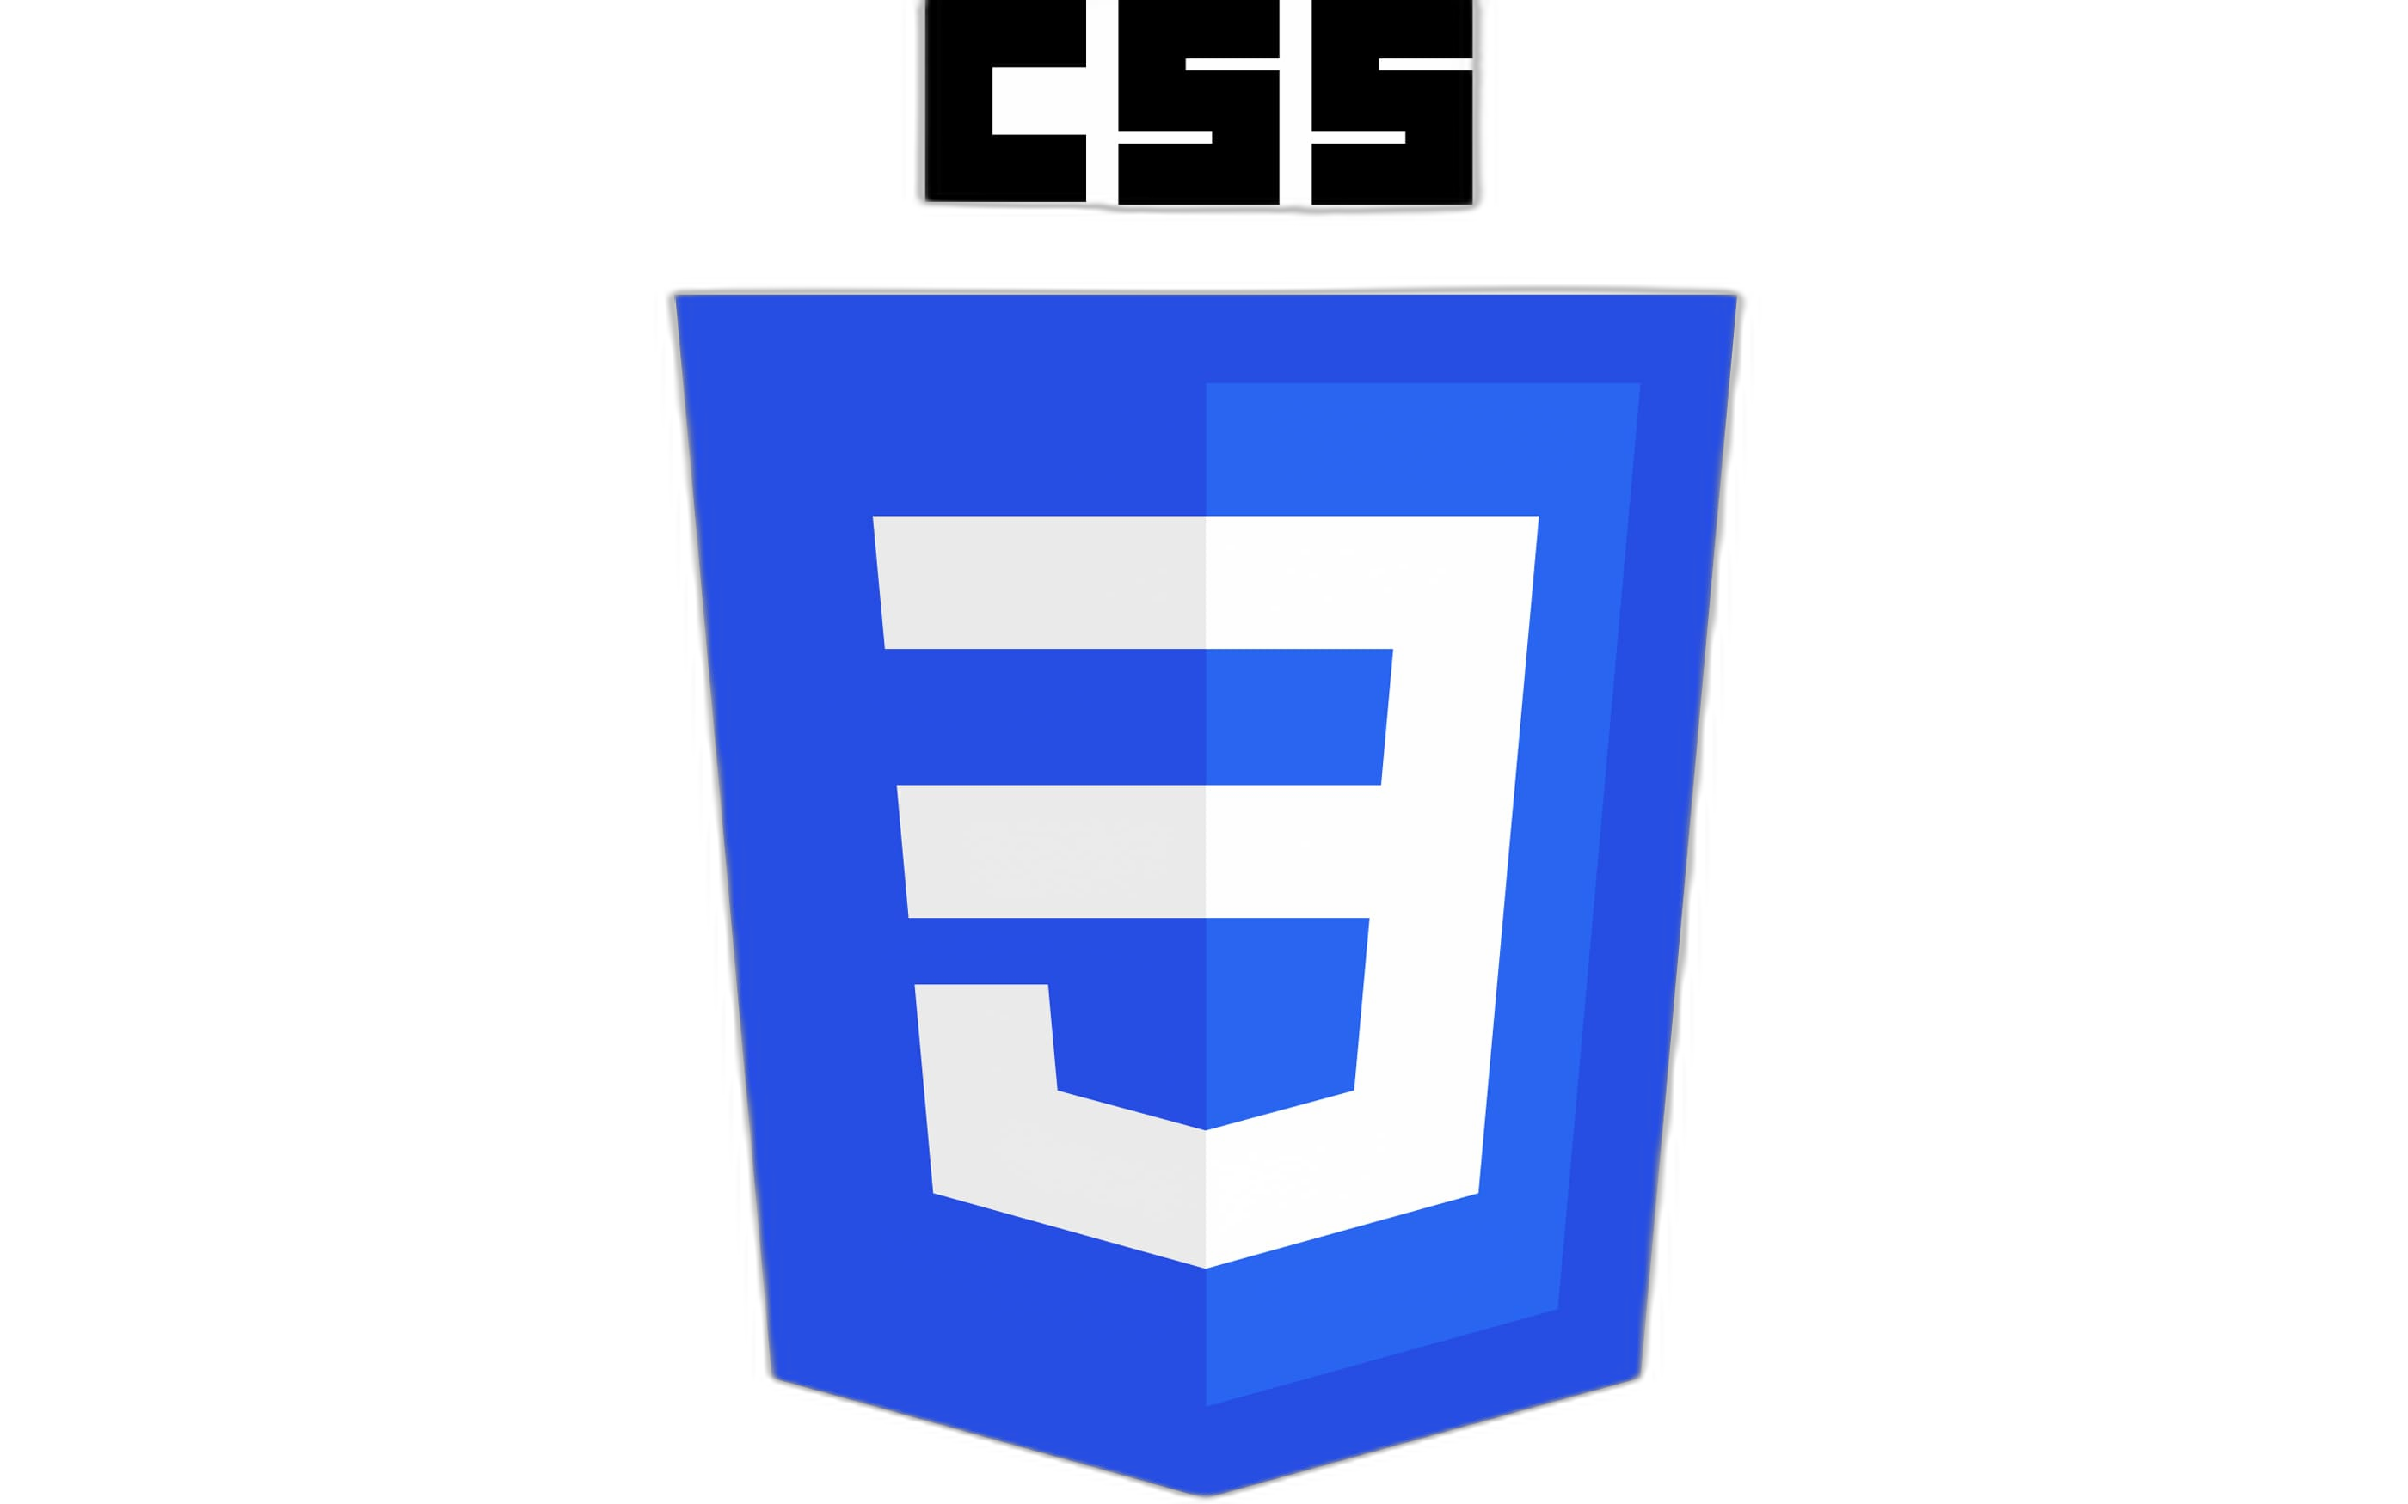

Technologies Used:
3. CSS
CSS stands for Cascading Style Sheets. It is a style sheet language which is used to describe the look and formatting of a document written in markup language. It provides an additional feature to HTML. It is generally used with HTML to change the style of web pages and user interfaces.
4.JavaScript
JavaScript is a scripting language that enables you to create dynamically updating content, control multimedia, animate images, and pretty much everything else. (Okay, not everything, but it is amazing what you can achieve with a few lines of JavaScript code.)

Slide 7
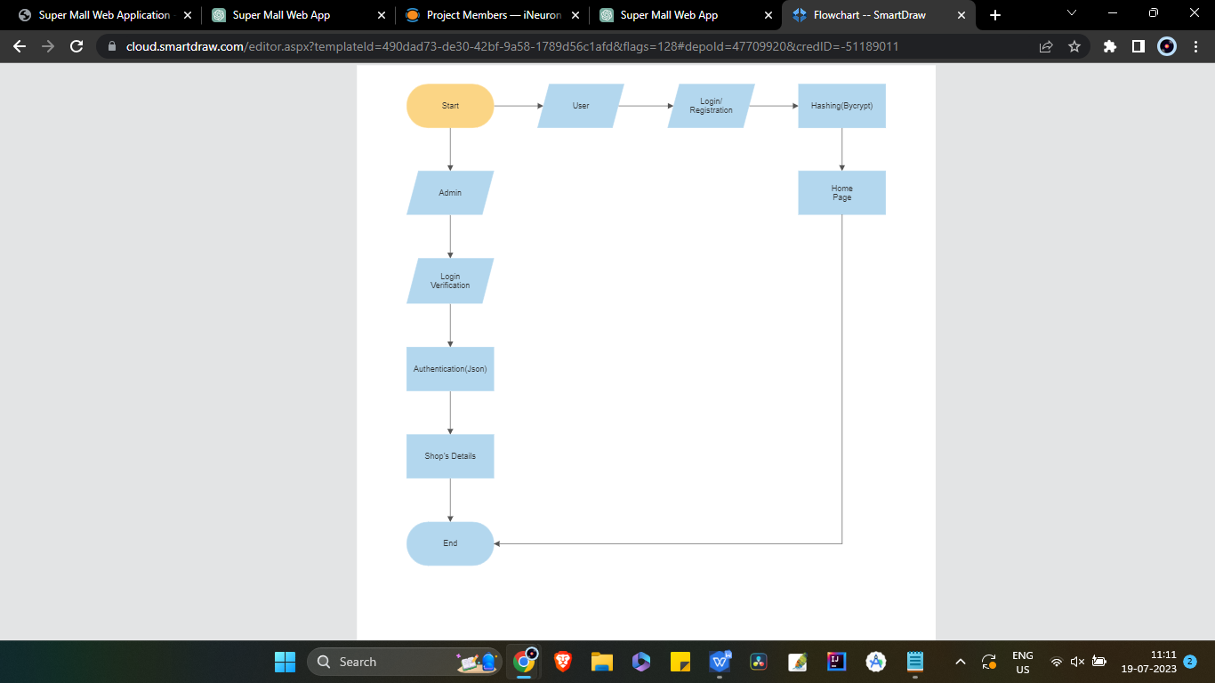
Architecture:

Slide 8
Software Requirements:
Operating System: Windows 7 & above
Coding Language: JavaScript, HTML, CSS
Database: MongoDB
Back End: Express.js(Node.js)
IDE: Visual Studio Code
Hardware Requirements:
Processor: i3 or above
Ram: 512MB
Hard Disk: 20GB+
Processor Speed: 2ghz+

Slide 9
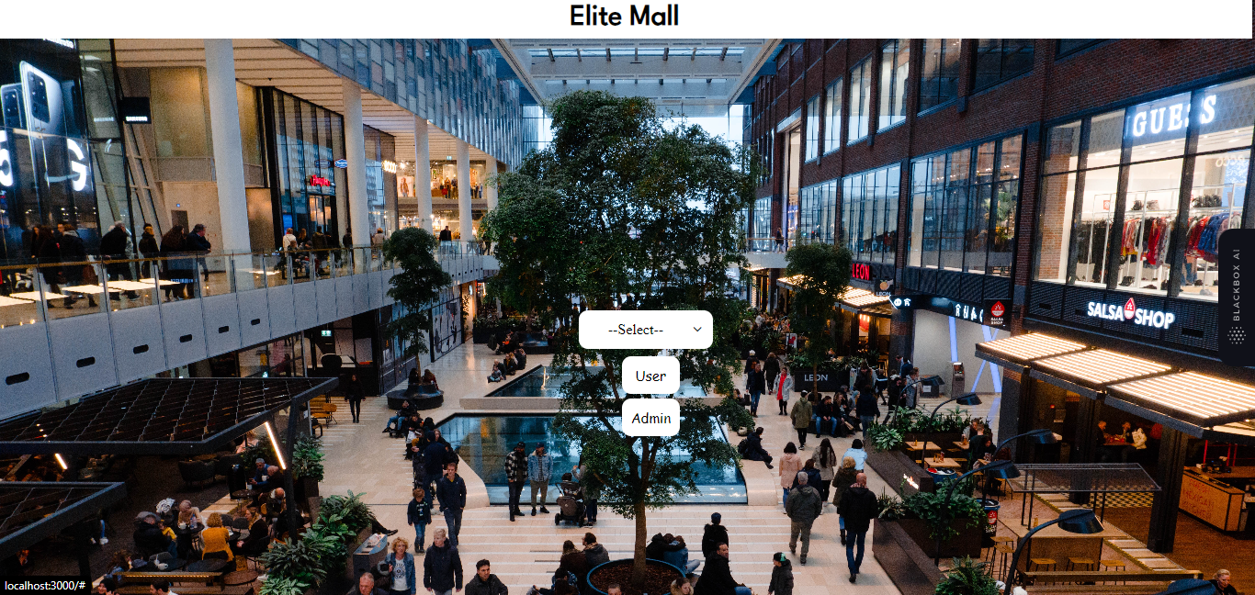

Slide 10
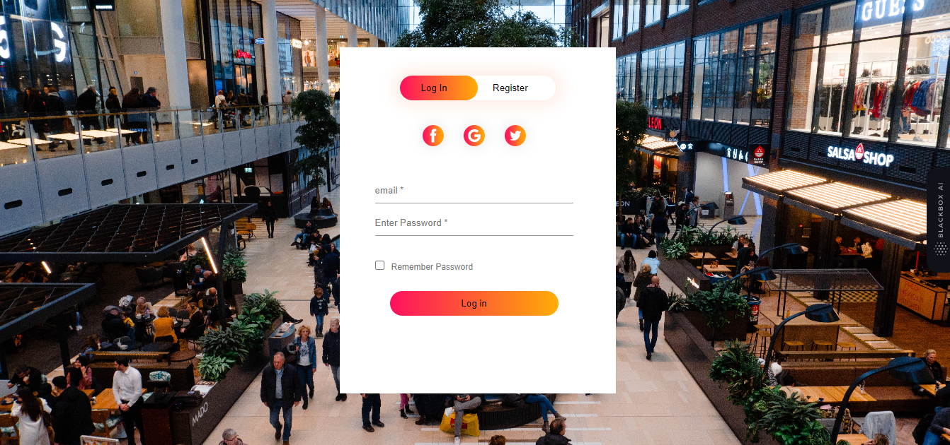

Slide 11
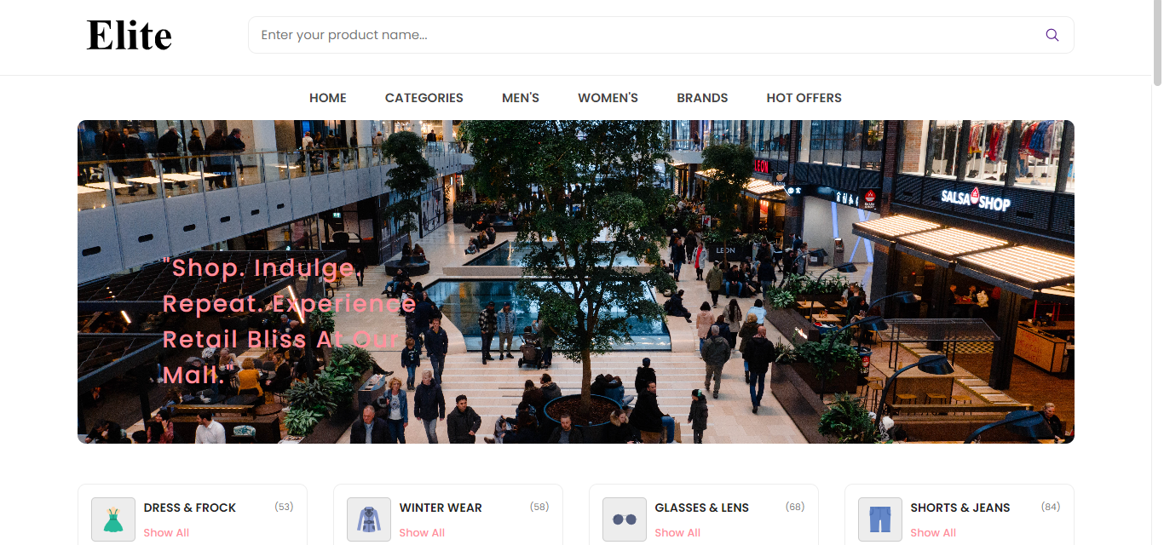

Slide 12
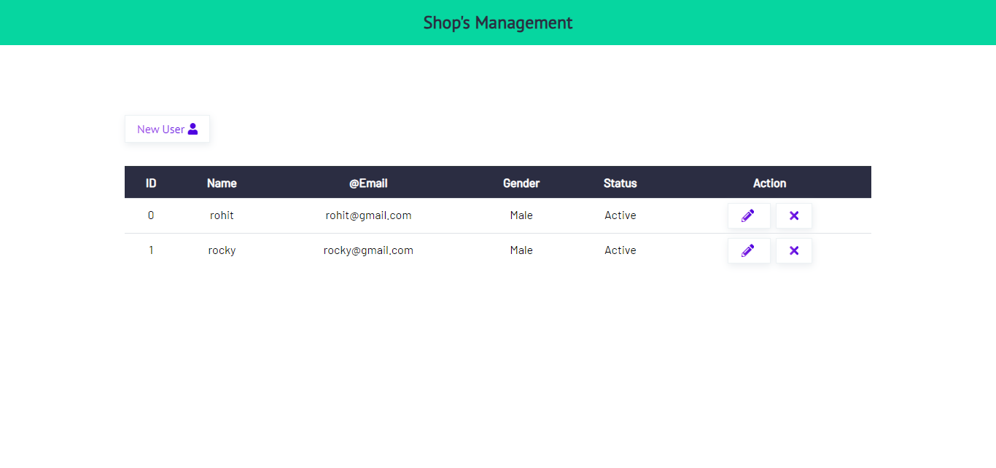

Slide 13
Conclusion
In conclusion, the Super Mall Web Application is a powerful tool for both shoppers and mall owners. With its user-friendly interface, fast performance, and secure login system, it provides a seamless shopping experience that is second to none.
Additionally, the application's modular design and use of RESTful APIs make it highly scalable and adaptable to meet the needs of any mall or shopping center. And with its robust security features, including bcrypt and jsonwebtoken, shoppers can rest assured that their personal information is safe and secure.
So whether you're a shopper looking for the ultimate shopping experience or a mall owner looking to take your business to the next level, the Super Mall Web Application is the perfect solution for you.

Slide 14
THANKS

